Slide 1

Chapter 1
BAIT3153 Software and Project Management (SPM)
Project Management Concepts
Notes:
This template was downloaded from www.free-power-point-templates.com
Links:
https://www.pexels.com/photo/macbook-pro-beside-black-ceramic-mug-on-black-table-3740704/

Slide 2
Table of Contents
Chapter 1
1.1 Introduction to Project Management
1.2 Project Life Cycle
1.3 Project Appraisal
1.4 Knowledge and Attributes of a Project Manager
1.5 Project Management Failure

Slide 3

1.1 An Introduction to Project Management
What is Project Management?
What is a Project?
Characteristics of Projects
Software vs Other Types of Projects
Constraints in Projects

Slide 4
What is Project Management?
1.1 Introduction to Project Management
Planning
A discipline that involves:
Planning - deciding what to be done (Project Initiation Document [PID] needs to be created)
Organising - making arrangement
Staffing - select personnel
Directing - give instructions
Monitoring - check on progress
Controlling - remedy hold-ups
Innovating - coming up with new solutions
Organising
Staffing
Directing
Controlling
Innovating

Slide 5
What is Project Management?
1.1 Introduction to Project Management
Planning
A discipline that involves:
Planning - deciding what needs to be done,
Organising - make arrangement
Staffing - select personnel
Directing - give instructions
Monitoring - monitor progress
Controlling - remedy hold-ups
Innovating - coming up with new solutions
Organising
(then… )
Staffing
When you want to do it? How you want to do it? Who ….
Directing
Controlling
Innovating

Slide 6

What is a Project?
1.1 Introduction to Project Management
“A specific plan or design”
“A planned undertaking”
“A large undertaking”
Examples of project
The ECRL (East Coast Rail Link)
Developing the Huawei’s Harmony OS
_________

Slide 7

Characteristics of Projects
1.1 Introduction to Project Management
Non-routine (e.g. FYP)
Planning is required (e.g. what needs to be done etc…)
Specific objectives to be met
Pre-determined time span (e.g. FYP 9 months)
Work is carried out for someone, i.e. clients
Involves several specialisms (e.g. database specialists, UI specialist, Network specialist, etc)
Involves several phases (e.g. analysis, design, code, test, implement, ________ )
Resources constraints is common
(e.g. Time, budget, staffs)
(e.g. Develop a student attendance system to reduce the amount of paper consumption by 99%)

Slide 8


Software vs Other Types of Projects
1.1 Introduction to Project Management
 | Software Project (e.g. developing XYZ operating system) | Other Types of Project (e.g. construction project)
Invisibility | progress is not immediately visible (no physical form) | progress is immediately visible (have physical form)
Conformity | have to conform to clients requirements | have to conform to physical laws (e.g. gravity law)
Complexity | Have more complexity than other engineered artefacts | less complex than software project
Flexibility | Easier to change | Difficult to change once it is completed

Slide 9
Constraints in Projects
1.1 Introduction to Project Management
Project managers need to face 3 major constraints:
Project managers’ mantra:
To develop a system [on time, within budget and to the required quality]
Time
Budget (Cost)
Quality
FYP students, your mantra =
To complete FYP project scope on time and to the required quality
Notes:
+++

Slide 10
1.1 Introduction to Project Management
Challenges in Software Projects
Challenges faced by project manager
Challenges faced by developers
Challenges faced by customers
Poor estimates and plans
Lack of quality standards and measures
Lack of guidance about making organisational decisions
Lack of techniques to make progress visible
Poor role definition – who does what?
Incorrect success criteria
Impossible deadlines
Scope changes (affect ?)
Resource constraints
Inadequate specification of work
Management ignorance of IT
Lack of knowledge of application area
Lack of standards
Lack of up-to-date documentations
Preceding activities not completed on time (This will cause what problem?)
Narrow scope of technical expertise
Changing user requirement
Deadline pressure
Lack of skill
Lack of communication
(e.g. need to wait for 1 more month then only can use the software)
The software
project is behind schedule
(problem = ?)
The developed software no longer meets the needs of the organization
The cost of the project has exceeded its allotted budget

Slide 11
1.2 Project Life Cycle
Generic Project Process Model
Project Life Cycle Processes
RFP and Proposals

Slide 12



Generic Project Process Model
1.2 Project Life Cycle
The project life cycle
4 stages:
Identify a need
Develop proposed solution
Perform the project
Terminate the project
Effort
Identify a Need
Develop proposed solution
Terminate the project
Perform the project
A good project is one that has successfully fulfilled the identified need!
RFP
Proposal
SDLC
Time
← Ana – des – cod – tes – imp →

Slide 13
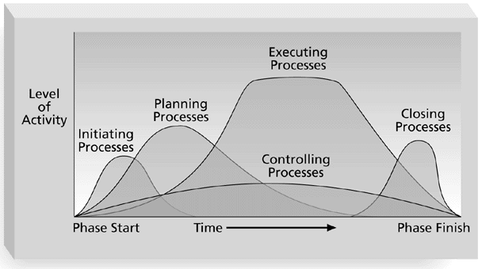
Project Life Cycle Processes
Initiating Processes
Planning Processes
Executing Processes
Monitoring & Controlling Processes
Closing Processes
1.2 Project Life Cycle
Perform the project
Terminate the project
Monitoring &
Identify a need
Develop proposed solution
Project Management Process Groups

Slide 14
(a) Initiating
Project Life Cycle Processes
Conduct a kick-off meeting to establish customer’s needs, goals, requirements and expected benefits.
Then 1 or 2 more meetings to streamline the project requirements
Output: Project Charter
Note: a project charter is a formal project authorization which documents the shared understanding of a project’s scope, development and objectives, while also defining the roles and responsibilities of each party involved. (https://thedigitalprojectmanager.com/project-charter/)

Slide 15
(b) Planning
Project Life Cycle Processes
Create a Project Management Plan (PMP) and kept it up-to-date as the project progresses.
PMP contains sufficient details to monitor and exercise control over the project execution e.g. project schedules, milestones, project team members, and all other project related information.
In maintenance projects, the detailed schedule is dynamically updated as and when maintenance requests are received and delivered.

Slide 16
(c) Executing
Project Life Cycle Processes
Once the plan is in place - execute the project
The Project Manager evaluates adherence to the project planning process and the work products and services of the process to the applicable requirements, objectives, and standards, and addresses noncompliance.
By ensuring adherence to the plan, information will be available to accurately identify issues and problems in their early stages and minimize risks.
Output: work results
(Give some examples of FYP work results = ? ____________ )

Slide 17
(d) Monitoring & Controlling
Project Life Cycle Processes
During the project execution, the Project Manager monitor the progress against the plan (means check if “project progress” = “What has been planned”
e.g. tasks completed on time?, if ans = “No”... )
For this, the Project Manager gathers the information needed, analyzes it and identifies any deviations significant (重大的偏差).
Take corrective actions to solve identified issues. This may include re-planning and establishing new agreements.
Output: overall health of project
(e.g. healthy if project is on time and within budget)
(What is the overall health of your FYP?)

Slide 18
(e) Closing
Project Life Cycle Processes
When the project is completed the Project Manager gathers the project related data and documents.
Handover the project’s product to the customer
(e.g. completed software, ________________ )
Conduct post project review (self refection).
Redeploy(重新调配) project resources

Slide 19
Project Life Cycle Processes
Quick
Review
Initiating Processes
Planning Processes
Executing Processes
Monitoring & Controlling Processes
Closing Processes
1.2 Project Life Cycle
3. Perform the project
4. Terminate the project
Monitoring &
1. Identify a need
2. Develop proposed solution
Project Management Process Groups

Slide 20
1.3 Project Appraisal
Things to do before project starts
Cash Flow Forecasting
Cost & Benefit Analysis
Financial Techniques
Net Profit
Payback Period
Return on Investment (ROI)
Net Present Value (NPV)
Weighted Scoring Model
to save the organisation from a bad decision or investment.

Slide 21



1.3 Project Appraisal
Cash Flow Forecasting
Positive cash flow during the product’s operating life
Income
Time
Expenditure
Decommissioning cost at the end of product’s life
Negative cash flow during Product development
Cash Flow Forecasting is …

Slide 22
Cost & Benefit Analysis
1.3 Project Appraisal
A comparative assessment of all the benefits you anticipate from the project and all the costs required to introduce the project, perform it and support the changes resulting from it.
Helps you to
Decide whether to undertake a project or decide which of several projects to undertake.
Frame appropriate project objectives.
Develop appropriate before and after measures of project success.
Prepare estimates of the resources required to perform the project work.

Slide 23
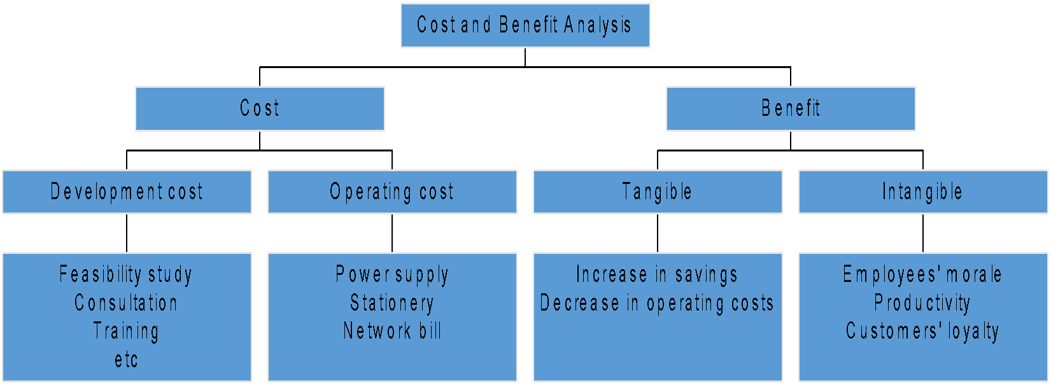
Cost & Benefit Analysis - Examples
- To conduct
-
(e.g. Consultation with security experts to perform a security assessment and implement best practices)
-

Slide 24
Cost & Benefit Analysis - Examples
- To conduct
-
(e.g. Consultation with security experts to perform a security assessment and implement best practices)
(Amt of money saved as a result automation)
Better reputation
-
Increase in revenue
(more sales)

Slide 25
1.3 Project Appraisal
Cash Flow Forecasting
Cost & Benefit Analysis
Financial Techniques
Net Profit
Payback Period
Return on Investment (ROI)
Net Present Value (NPV)
Measure project profitability

Slide 26


Net Profit (NP)
1.3 Project Appraisal
Net profit = total income - total costs (over the life of the project)
E.g. (negative sign = cost)
Year | Project 1 | Project 2 | Project 3 | Project 4
0 | -100,000 | -1,000,000 | -100,000 | -120,000
1 | 10,000
2 | 10,000
3 | 10,000
4 | 20,000
5 | 100,000
200,000 | 30,000 | 30,000
200,000 | 30,000 | 30,000
200,000 | 30,000 | 30,000
200,000 | 30,000 | 30,000
300,000 | 30,000 | 75,000
Net Profit | 50,000
100,000 | 50,000 | 75,000
Table 1.1 4 project cash flow projections – figures are end of year totals (RM)
Based on NP technique alone which project you would approve for development?

Slide 27
Net Profit
1.3 Project Appraisal
Year | Project 1 | Project 2 | Project 3 | Project 4
0 | -100,000 | -1,000,000 | -100,000 | -120,000
1 | 10,000 | 200,000 | 30,000 | 30,000
2 | 10,000 | 200,000 | 30,000 | 30,000
3 | 10,000 | 200,000 | 30,000 | 30,000
4 | 20,000 | 200,000 | 30,000 | 30,000
5 | 100,000 | 300,000 | 30,000 | 75,000
Net Profit | 50,000 | 100,000 | 50,000 | 75,000
Disadvantages
NP technique does not consider the time value of money (See Project 2, Year 5)
(note: the value of a dollar received in the future is not the same as a dollar received today)
Project 1 & 3 have equal cost & net profit but are both projects equally preferable?
To ans this question you need to analyse further
(Project 1 has bulk of income occurs late in the life of the project. Having to wait longer for a return is a disadvantage. Project 3 returns a steady income throughout its life. Thus, project 1 & 3 are not equally preferable)
Advantages
Easy to calculate and intuitive.

Slide 28
Payback Period
1.3 Project Appraisal
Calculate the time needed to break even or pay back the initial investment.
Normally project with the shortest payback period will be chosen on the basis that an organization will wish to minimize the time that a project is ‘in debt’.
How to calculate payback period?
(Subtract each individual annual cash inflow from the initial cash outflow, until the payback period is achieved)

Slide 29
Payback Period
1.3 Project Appraisal
What is the payback period for Project 1, 2, 3 and 4?
Year | Project 1 | Project 2 | Project 3 | Project 4
0 | -100,000 | -1,000,000 | -100,000 | -120,000
1 | 10,000 | 200,000 | 30,000 | 30,000
2 | 10,000 | 200,000 | 30,000 | 30,000
3 | 10,000 | 200,000 | 30,000 | 30,000
4 | 20,000 | 200,000 | 30,000 | 30,000
5 | 100,000 | 300,000 | 30,000 | 75,000
Net Profit | 50,000 | 100,000 | 50,000 | 75,000
Table 1.2 Four project cash flow projections – figures are end of year totals (RM)

Slide 30
Payback Period
1.3 Project Appraisal
What is the payback period for Project 1, 2, 3 and 4?
Year | Project 1 | Project 2 | Project 3 | Project 4
0 | -100,000 | -1,000,000 | -100,000 | -120,000
1 | 10,000 | 200,000 | 30,000 | 30,000
2 | 10,000 | 200,000 | 30,000 | 30,000
3 | 10,000 | 200,000 | 30,000 | 30,000
4 | 20,000 | 200,000 | 30,000 | 30,000
5 | 100,000 | 300,000 | 30,000 | 75,000
Net Profit | 50,000 | 100,000 | 50,000 | 75,000
Net Profit | 50,000 | 100,000 | 50,000 | 75,000
Table 1.2 Four project cash flow projections – figures are end of year totals (RM)
Using payback period technique, Project 3 has the shortest payback period.
(Project 3 breakeven in early Y4. Project 4 breakeven at the end of Y4)
But Net Profit analysis shows that Project 2 and Project 4 are more profitable than Project 3.

Slide 31
Payback Period
1.3 Project Appraisal
Year | Project 1 | Project 2 | Project 3 | Project 4
0 | -100,000 | -1,000,000 | -100,000 | -120,000
1 | 10,000 | 200,000 | 30,000 | 30,000
2 | 10,000 | 200,000 | 30,000 | 30,000
3 | 10,000 | 200,000 | 30,000 | 30,000
4 | 20,000 | 200,000 | 30,000 | 30,000
5 | 100,000 | 300,000 | 30,000 | 75,000
Net Profit | 50,000 | 100,000 | 50,000 | 75,000
IF project 3 is chosen, company will missed 75K in Project 4
Disadvantages:
It ignores any profits generated after the payback period (e.g. compare Project 3 and project 4)
PP technique also does not consider the time value of money (It does not discount future cash flows)
Advantages:
Easy to calculate and understand
Projects with shorter payback periods are generally less risky (as they recover their investment faster, reducing exposure to uncertainties)

Slide 32
Return on Investment (ROI)
1.3 Project Appraisal
Aka Accounting Rate of Return (ARR)
Provides a way of comparing the net profitability to the investment required.
Formula:
average annual profit
ROI =
X 100
total investment

Slide 33
Return on Investment (ROI)
1.3 Project Appraisal
What is the ROI for Project 1, 2, 3 and 4?
Calculate ROI:
Project 1
ROI = (50,000/5) x 100 = 10%
100,000
Year | Project 1 | Project 2 | Project 3 | Project 4
0 | -100,000 | -1,000,000 | -100,000 | -120,000
1 | 10,000 | 200,000 | 30,000 | 30,000
2 | 10,000 | 200,000 | 30,000 | 30,000
3 | 10,000 | 200,000 | 30,000 | 30,000
4 | 20,000 | 200,000 | 30,000 | 30,000
5 | 100,000 | 300,000 | 30,000 | 75,000
Net Profit | 50,000 | 100,000 | 50,000 | 75,000
ROI | ? | ? | ? | ?
Avg annual profit
Tot investment
Project 2
ROI = (100,000/5) x 100 = 2%
1,000,000
Table 1.3 Four project cash flow projections – figures are end of year totals (RM)

Slide 34
Return on Investment (ROI)
1.3 Project Appraisal
Year | Project 1 | Project 2 | Project 3 | Project 4
0 | -100,000 | -1,000,000 | -100,000 | -120,000
1 | 10,000 | 200,000 | 30,000 | 30,000
2 | 10,000 | 200,000 | 30,000 | 30,000
3 | 10,000 | 200,000 | 30,000 | 30,000
4 | 20,000 | 200,000 | 30,000 | 30,000
5 | 100,000 | 300,000 | 30,000 | 75,000
Net Profit | 50,000 | 100,000 | 50,000 | 75,000
ROI | 10% | 2% | 10% | 12.5%
Table 1.3 Four project cash flow projections – figures are end of year totals (RM)
Which project is most worthwhile based on ROI alone?

Slide 35
Return on Investment (ROI)
1.3 Project Appraisal
Year | Project 1 | Project 2 | Project 3 | Project 4
0 | -100,000 | -1,000,000 | -100,000 | -120,000
1 | 10,000 | 200,000 | 30,000 | 30,000
2 | 10,000 | 200,000 | 30,000 | 30,000
3 | 10,000 | 200,000 | 30,000 | 30,000
4 | 20,000 | 200,000 | 30,000 | 30,000
5 | 100,000 | 300,000 | 30,000 | 75,000
Net Profit | 50,000 | 100,000 | 50,000 | 75,000
ROI | 10% | 2% | 10% | 12.5%
Advantages:
Simple and easy to calculate
Return rate provides a clear indicator of the potential returns
Disadvantages:
Does not consider the time value of money.
High ROI but a long payback period may not be good.

Slide 36
Net Present Value (NPV)
1.3 Project Appraisal
NPV takes into account the time value of money.
Is a financial method used to determine the current/present value of all future cash flows generated by a project including the initial capital investment.
2 views:
Receiving RM100 today is better than having to wait until next year to receive it.
- The present value of RM100 in a year’s time is RM91.
mean Y1 (RM100) = Y0 (RM91), Y0= Now, Y1=1 year later
(assuming Discount rate = 10%)
Invest RM100 in a bank today and have RM110 in a year’s time
(assuming Discount rate = 10%).
Why RM110?
Notes:
The accepted average car depreciation rate is roughly 15% per year. This rate will vary depending on the make and model of the vehicle. New cars depreciate about 20% the moment you drive them off the lot. The second and third year the vehicle will probably depreciate roughly 15% a year. After year five, depreciation rates slow down. There are websites such as MoneyZine that offer a car depreciation calculator.

Slide 37
Net Present Value (NPV)
1.3 Project Appraisal
How to calculate the Present Value of a future cash flow ?
discount factor
Present Value
of a future cash flow =
1
Cash Flow in Year t X
(1 + r)^{t}
where
r is the discount rate (expressed as a decimal value)
t is the number of years into the future that the cash flow occurs

Slide 38
Net Present Value (NPV)
1.3 Project Appraisal
1/(1+0.10)⁰
Example: Calculate the NPV for project 1
Assuming discount rate = 10%
Year | Project 1 Cash Flow (RM) | Discount Factor | Discounted cash flow or Present Value
0 (NOW) | -100,000 | 1.0000 | -100,000
1 | 10,000 | 0.9091 | 9,091
2 | 10,000 | 0.8264 | 8,264
3 | 10,000 | 0.7513 | 7,513
4 | 20,000 | 0.6830 | 13,660
5 | 100,000 | 0.6209 | 62,090
Present value of future cash flow
NPV: RM618
Future cash flow
1/(1+0.10)⁵

Slide 39
Net Present Value (NPV)
Based on NPV alone, is Project 3 more beneficial to pursue than Project 1 (NPV = RM618)?
1.3 Project Appraisal
Exercise
Using a 10% discount rate, calculate the NPV for Project 3.
.
Yes,
i) A positive NPV indicates the project is profitable [PV of cash inflows (benefits) > PV of cash outflows (costs) over the 5-year period]
ii) Project 3 NPV is > Project 1 (P3 is > profitable than P1)
Year | Project 3 Cash Flow (RM) | Discount Factor @ 10% | Discounted cash flow or Present Value
0 | -100,000 | 1.0000 | -100,000
1 | 30,000 | 0.9091 | 27,273
2 | 30,000 | 0.8264 | 24,792
3 | 30,000 | 0.7513 | 22,539
4 | 30,000 | 0.6830 | 20,490
5 | 30,000 | 0.6209 | 18,627
Net Profit | 50,000 |  | NPV: RM13,721
(assuming all other factors are equal)

Slide 40
Net Present Value (NPV)
1.3 Project Appraisal
The discount rate can be thought of as a target rate of return.
If we set a target rate of return of 15% we would reject any project that did not display a NPV > 0

Slide 41
Net Present Value (NPV)
1.3 Project Appraisal
Year | Project 2 Cash Flow (RM) | Discount Factor @ 10% | Discounted Cash Flow
0 | -1,000,000 | 1.0000 | -1,000,000
1 | 200,000 | 0.9091 | 181,820
2 | 200,000 | 0.8264 | 165,280
3 | 200,000 | 0.7513 | 150,260
4 | 200,000 | 0.6830 | 136,600
5 | 300,000 | 0.6209 | 186,270
Net Profit | 100,000 |  | NPV: -179,770
Is it worth to pursue Project 2?
No : Project 2’s NPV is negative which indicates that it does not achieve the 10% target rate of return.
Project 2’s PV of cash outflows(costs) > PV of cash inflows (benefits) over the 5-year period]. It is a net loss.

Slide 42
Exercise: Using a discount rate of 9%, calculate the NPV and ROI for Project B.
Project B | Year 0 | Year 1 | Year 2 | Year 3 | Total
Costs | 100,000 | 60,000 | 60,000 | 50,000
Discount Factor
Discounted Costs
Benefits | 0 | 80,000 | 90,000 | 180,000
Discount Factor
Discounted Benefits
Discounted benefits – costs | (100,000)
Cumulative benefits - costs | (100,000)
ROI

Slide 43
Exercise: Using a discount rate of 9%, calculate the NPV and ROI for Project B.
ROI = NPV / Discounted Cost x 100%
Project B | Year 0 | Year 1 | Year 2 | Year 3 | Total
Costs | 100,000 | 60,000 | 60,000 | 50,000
Discount Factor | 1.0000
Discounted Costs | 100,000
Benefits | 0 | 80,000 | 90,000 | 180,000
Discount Factor | 1.0000
Discounted Benefits | 0
Discounted benefits – costs | (100,000)
Cumulative Discounted benefits – costs | (100,000) | (81,652) | (56,401) | 43,985
ROI =
0.9174 | 0.8417 | 0.7722
55,044 | 50,502 | 38,610
244,156
288,141
NPV =
0.9174 | 0.8417 | 0.7722
73,392 | 75,753 | 138,996
18,348 | 25,251 | 100,386
43,985
Total Discounted Benefits – Total Discounted Cost / Total Discounted Cost x 100%
= (43,985/244,156 ) X 100% = 18.02%

Slide 44
1.3 Project Appraisal
Quick Review
Cash Flow Forecasting
Cost & Benefit Analysis
Financial Techniques
Net Profit
Payback Period
Return on Investment (ROI)
Net Present Value (NPV)
Things to do ____ project starts
to ____ the organisation from a bad decision or investment.
Measure project profitability

Slide 45
L2: Quick Review of PrevL
1.1 Introduction to Project Management
What is PM?, What is a project? Characteristics of project, Software projects Vs other types of projects, Challenges in software projects
1.2 Project Life Cycle
4 stages, PLC processes
1.3 Project Appraisal
Cash flow forecasting, Cost & benefits analysis
Financial techniques: NP, PP, ROI, NPV
Non-financial technique: __________
1.4 Knowledge and Attributes of a Project Manager
1.5 Project Management Failure

Slide 46
Weighted Scoring Model
1.3 Project Appraisal
- High score means the project strongly meet the specified criterion
Specify the relevant criterion for project selection
(NPV, ROI can be the criterion)
Weight the importance of each criterion.
Assign a score (0 to 100) to each criterion
- Low score means the project is less likely to meet the specified criterion
Criteria (for project selection) | Weight (%) | Project 1 | Project 2 | Project 3
Support business objectives | 10%
Availability of resources | 10%
Duration < 12 months | 10%
Low risk | 5%
High probability of project success | 15%
Good ROI (above 40%) | 50%
Weighted Project Scores | 100%
80 | 90 | 50
70 | 70 | 50
70 | 90 | 50
50 | 50 | 50
90 | 90 | 50
80 | 90 | 50
50% means Good ROI is a very important criteria
78 | 86 | 50
Weighted Project Scores for Project 2: (10% * 90) + (10% * 70) + (10% * 90) + (5% * 50) + (15% * 90) + (50% * 90) = 86
Choose project with the highest score!
Notes:
Source: https://www.mpug.com/no-pain-no-gain/

Slide 47

1.4 Knowledge & Attributes of a Project Manager (PM)
Knowledge of a PM
Attributes of a PM

Slide 48

Knowledge of a PM
1.4 Knowledge & Attributes of a Project Manager
10 Knowledge Areas
Scope
Stakeholders
Time
Integration
Procurement
Cost
Risk
Quality
Communication
Human Resource

Slide 49
PLC/S1 + 2
PLC/S3 (PERFORM THE PROJECT)
PLC/S4
Project Management Process Group and Knowledge Area Mapping
 | Initiating | Planning | Executing | M&C | Closing
Integration | Develop Project Charter | Develop PM Plan | Direct & Manage Project Work | M&C Project Work Perform Integrated Change Control | Close Project or Phase
Scope |  | Plan Scope Management Collect Requirements Define Scope Create WBS |  | Validate Scope Control Scope
Time |  | Plan Schedule Management Define Activities Sequence Activities Estimate Activity Resources Estimate Activity Durations Develop Schedule |  | Control Schedule
Cost |  | Plan Cost Management Estimate Costs Determine Budget |  | Control Costs
Quality |  | Plan Quality Management | Perform Quality Assurance | Control Quality
HR |  | Plan HR Management | Acquire Project Team Develop Project Team Manage Project Team
Communications |  | Plan Communications Management | Manage Communications | Control Communications
Risk |  | Plan Risk Management Identify Risks Perform Qualitative Risk Analysis Perform Quantitative Risk Analysis Plan Risk Responses |  | Control risks
Procurement |  | Plan Procurement Management | Conduct Procurements | Control Procurements | Close Procurements
Stakeholder | Identify Stakeholders | Plan Stakeholder Management | Manage Stakeholder Expectation | Monitor Stakeholder Engagement
Notes:
47 processes

Slide 50

Project Scope Management
1.4 Knowledge & Attributes of a Project Manager
Define and control what work is and is not included in a project.
ensures that the project team and stakeholders have the same understanding of deliverable (products) and what processes the project team will use to produce them.
6 main processes:
Plan scope management
Collect requirements
Define scope
Create WBS
Validate scope
Control scope
(Exclusion)

Slide 51
Project Scope Management
1.4 Knowledge & Attributes of a Project Manager
1. Plan scope management
2. Collect requirements
3. Define scope
4. Create WBS
5. Validate scope
6. Control scope
Plan scope management
Scope defines what work will be done and what won’t.
Scope mgmt define how scope will be managed throughout the project
to prevent uncontrolled changes

Slide 52
Project Scope Management
1.4 Knowledge & Attributes of a Project Manager
1. Plan scope management
2. Collect requirements
3. Define scope
4. Create WBS
5. Validate scope
6. Control scope
2. Collect Requirements
Gather and document the needs of stakeholders (customer/project sponsor) and translate them into project requirements.

Slide 53
Project Scope Management
1.4 Knowledge & Attributes of a Project Manager
1. Plan scope management
2. Collect requirements
3. Define scope
4. Create WBS
5. Validate scope
6. Control scope
3. Define Scope
Review the project charter, requirements documents, and organizational process assets to create a scope statement (what are included and excluded)
Adding more information to the scope statement as requirements are developed and change requests are approved.
Notes:
Organizational process assets (OPA): include any or all process related assets from any or all organizations involved in the project that can be used to have an influence on the project outcome. They include but are not limited to policies and procedures, formal and informal plans and guidelines, lessons learned and historical information.

Slide 54
Project Scope Management
1.4 Knowledge & Attributes of a Project Manager
1.0 Concept
1.1 Evaluate current systems
1.2 Define requirements
1.2.1 Define user requirements
1.2.2 Define content requirements
1.2.3 Define system requirements
1.2.4 Define server owner requirements
1.3 Define specific functionality
1.4 Define risks and risk management approach
1.5 Develop project plan
1.6 Brief Web development team
2.0 Web site design
3.0 Web site development
4.0 Roll out
5.0 Support
1. Plan scope management
2. Collect requirements
3. Define scope
4. Create WBS
5. Validate scope
6. Control scope
4. Create A Work Breakdown Structure (WBS)
Subdivide the major project activities into smaller, more manageable components.
WBS is a hierarchy of activities.
Can be organized around project products, project phase, or using the project management process groups.
Guideline: breakdown the work until each task can be performed by 1 person within 8-80 hours (1-10 days)
Notes:
Scope baseline:
The scope baseline is the approved version of a scope statement, WBS, and its associated WBS dictionary, that can be changed only through formal change control procedures and is used as a basis for comparison. It is a component of the project management plan. Components of the scope baseline include:
-project scope statement
-WBS
-WBS dictionary
-

Slide 55
Project Scope Management
1.4 Knowledge & Attributes of a Project Manager
Organized the WBS by phases/stages in OUTLINE NUMBERING format
1.0 Concept
1.1 Evaluate current systems
1.2 Define requirements
1.2.1 Define user requirements
1.2.2 Define content requirements
1.2.3 Define system requirements
1.2.4 Define server owner requirements
1.3 Define specific functionality
1.4 Define risks and risk management approach
1.5 Develop project plan
1.6 Brief Web development team
2.0 Web site design
3.0 Web site development
4.0 Roll out
5.0 Support
Q) There are how many phases or stages in this WBS?

Slide 56
Project Scope Management
1.4 Knowledge & Attributes of a Project Manager
1. Arrange WBS in logical sequence
2. Indent sub-tasks
1.0 Concept
1.1 Evaluate current systems
1.2 Define requirements
1.2.1 Define user requirements
1.2.2 Define content requirements
1.2.3 Define system requirements
1.2.4 Define server owner requirements
1.3 Define specific functionality
1.4 Define risks and risk management approach
1.5 Develop project plan
1.6 Brief Web development team
2.0 Web site design
3.0 Web site development
4.0 Roll out
5.0 Support
1.0 Concept
1.1 Evaluate current systems
1.2 Define requirements
1.2.1 Define user requirements
1.2.2 Define content requirements
1.2.3 Define system requirements
1.2.4 Define server owner requirements
1.3 Define specific functionality
1.4 Define risks and risk management approach
1.5 Develop project plan
1.6 Brief Web development team
2.0 Web site design
3.0 Web site development
4.0 Roll out
5.0 Support
1. Plan scope management
2. Collect requirements
3. Define scope
4. Create WBS
5. Validate scope
6. Control scope
4. Create Work Breakdown Structure (WBS)
Subdivide the major project deliverables into smaller, more manageable components.
WBS is a hierarchy of activities.
Can be organized around project products, project phase, or using the project management process groups.
Guideline: breakdown the work until each task can be performed by 1 person within 8-80 hours (1-10 days)
Notes:
Scope baseline:
The scope baseline is the approved version of a scope statement, WBS, and its associated WBS dictionary, that can be changed only through formal change control procedures and is used as a basis for comparison. It is a component of the project management plan. Components of the scope baseline include:
-project scope statement
-WBS
-WBS dictionary
-

Slide 57
Project Scope Management
1.4 Knowledge & Attributes of a Project Manager
1.0 Concept
1.1 Evaluate current systems
1.2 Define requirements
1.2.1 Define user requirements
1.2.2 Define content requirements
1.2.3 Define system requirements
1.2.4 Define server owner requirements
1.3 Define specific functionality
1.4 Define risks and risk management approach
1.5 Develop project plan
1.6 Brief Web development team
2.0 Web site design
3.0 Web site development
4.0 Roll out
5.0 Support
1. Plan scope management
2. Collect requirements
3. Define scope
4. Create WBS
5. Validate scope
6. Control scope
5. Validate Scope
To formalize acceptance of the project deliverables
Let Stakeholders (customer/project sponsor) inspect and formally accept deliverable during this process.
If not acceptable, stakeholder usually request for changes

Slide 58
Project Scope Management
1.4 Knowledge & Attributes of a Project Manager
1.0 Concept
1.1 Evaluate current systems
1.2 Define requirements
1.2.1 Define user requirements
1.2.2 Define content requirements
1.2.3 Define system requirements
1.2.4 Define server owner requirements
1.3 Define specific functionality
1.4 Define risks and risk management approach
1.5 Develop project plan
1.6 Brief Web development team
2.0 Web site design
3.0 Web site development
4.0 Roll out
5.0 Support
1. Plan scope management
2. Collect requirements
3. Define scope
4. Create WBS
5. Validate scope
6. Control scope
6. Control Scope
Control changes to project scope throughout the life of the project.

Slide 59
Knowledge of a PM
1.4 Knowledge & Attributes of a Project Manager
10 Knowledge Areas
Scope
Stakeholders
Time
Integration
Procurement
Cost
Risk
Quality
Communication
Human Resource

Slide 60

Project Time Management
1.4 Knowledge & Attributes of a Project Manager
7 main processes:
Plan Schedule Management
Define Activities
Sequence Activities
Estimate Activity Resources
Estimate Activity Durations
Develop Schedule
Control Schedule

Slide 61

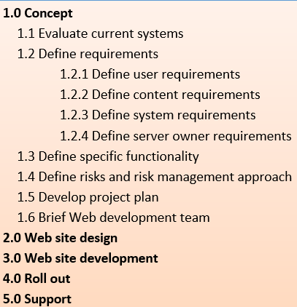
Project Time Management
E.g1. unit of measurement for duration is
(hours/days/weeks)
1.4 Knowledge & Attributes of a Project Manager
1. Plan Schedule Management
2. Define Activities
3. Sequence Activities
4.
Estimate Activity Resources
5. Estimate Activity Durations
6. Develop Schedule
7. Control Schedule
St.DT | En.DT | DUR | DEPEN, etc
E.g.2. duration of each task should not be > 10 days
1. Plan Schedule Management
Establish policies, procedures, and documentation for planning, developing, managing, executing, and controlling the project schedule.
E.g.3. date format use dd/mm/yyyy

Slide 62
Project Time Management
1.4 Knowledge & Attributes of a Project Manager
1. Plan Schedule Management
2. Define Activities
3. Sequence Activities
4.
Estimate Activity Resources
5. Estimate Activity Durations
6. Develop Schedule
7. Control Schedule
2. Define Activities
Identify the specific activities (from the WBS) that the project team members and stakeholders must perform to produce the project deliverables.
Outputs: activity list, activity attributes, and milestone list.
What are activity attributes?
Ans – detailed description of an activity.
Examples: description of the activity, responsible person, resources required, location, etc
Project stages

Slide 63
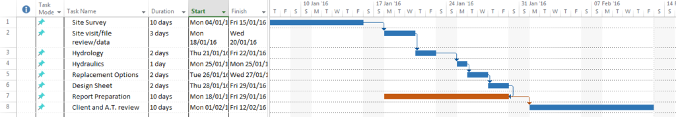
Project Time Management
1.4 Knowledge & Attributes of a Project Manager
1. Plan Schedule Management
2. Define Activities
3. Sequence Activities
4.
Estimate Activity Resources
5. Estimate Activity Durations
6. Develop Schedule
7. Control Schedule
3. Sequence Activities
Identify and document the relationships between project activities.
(specify the predecessor to sequence project activities)
Main output: Gantt Chart

Slide 64
Project Time Management
1.4 Knowledge & Attributes of a Project Manager
1. Plan Schedule Management
2. Define Activities
3. Sequence Activities
4.
Estimate Activity Resources
5. Estimate Activity Durations
6. Develop Schedule
7. Control Schedule
4. Estimate Activity Resources
Estimate the amount of resources (people, equipment, and materials) needed to perform the activities.
Outputs: activity resource requirements, resource breakdown structure

Slide 65
Project Time Management
1.4 Knowledge & Attributes of a Project Manager
1. Plan Schedule Management
2. Define Activities
3. Sequence Activities
4.
Estimate Activity Resources
5. Estimate Activity Durations
6. Develop Schedule
7. Control Schedule
5. Estimate Activity Durations
Estimate durations(days/weeks) needed to complete each activity.
Tool and techniques: three-point estimates
Main outputs: activity duration estimates.
Notes:
Work Period
a part of production time during which workers operate directly on an object of labor in order to produce a finished product of labor. A work period does not include interruptions in the labor process or the time during which an object of labor is acted upon by natural forces without human participation, for example, in drying wood and in chemical reactions.
Upon considering the relationship between a work period and a workday, K. Marx characterized a work period as being “a definite number of consequent workdays required in a certain branch of a production sector for the completion of the finished product” (K. Marx and F. Engels, Soch, 2nd ed., vol. 24, p. 259). Work periods differ in length in different branches of material production, depending on both the nature of the production process and the product of labor being manufactured. For example, yarn and fabrics are made in a few hours, while a rug may take a week to make and a tapestry may take years. A modular residential building can be constructed in several months, while a large electric power plant takes several years to build.

Slide 66
Project Time Management
1.4 Knowledge & Attributes of a Project Manager
1. Plan Schedule Management
2. Define Activities
3. Sequence Activities
4.
Estimate Activity Resources
5. Estimate Activity Durations
6. Develop Schedule
7. Control Schedule
6. Develop Schedule
Analyze activity sequences, activity resource estimates, and activity duration estimates to create the project schedule.
Outputs: project schedule, schedule baseline, schedule data, project calendars.

Slide 67
Project Time Management
1.4 Knowledge & Attributes of a Project Manager
1. Plan Schedule Management
2. Define Activities
3. Sequence Activities
4.
Estimate Activity Resources
5. Estimate Activity Durations
6. Develop Schedule
7. Control Schedule
7. Control Schedule
Monitor and manage changes to the project schedule to ensure the project is completed on time.
Update the schedule as needed to reflect changes
Take corrective actions if there is any schedule issues.

Slide 68
Knowledge of a PM
1.4 Knowledge & Attributes of a Project Manager
10 Knowledge Areas
Scope
Stakeholders
Time
Integration
Procurement
Cost
Risk
Quality
Communication
Human Resource

Slide 69

Project Cost Management
1.4 Knowledge & Attributes of a Project Manager
Includes the processes required to ensure that project team completes a project within an approved budget.
4 processes:
Plan Cost Management
Estimate Cost
Determine Budget
Control Costs

Slide 70
Project Cost Management
1.4 Knowledge & Attributes of a Project Manager
1. Plan Cost Management
2. Estimate Cost
3. Determine Budget
4. Control Costs
1. Plan Cost Management
Establish the policies, procedures, and documentation for planning, managing, expending, and controlling project costs.
Outputs: cost management plan.
Notes:
Variance threshold: amount of degree of variation that will trigger a remedial action or warning

Slide 71
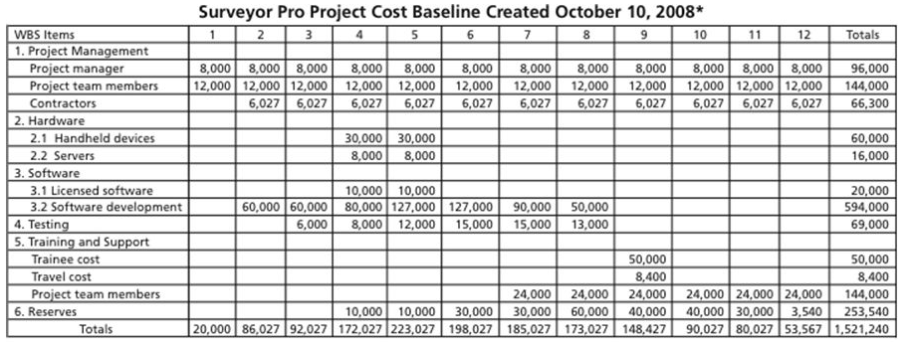
Project Cost Management
1.4 Knowledge & Attributes of a Project Manager
2. Estimate Cost
To estimate cost need to know all the resources needed to complete the project - E.g. people , hardware, software, etc
Outputs: activity cost estimates & basis of estimates
(mentioned also the quantity of each resource needed)
(The assumptions made when preparing the costs estimate)
Cost item by category

Slide 72
Project Cost Management
1.4 Knowledge & Attributes of a Project Manager
COST = forecasted amount to pay to complete a project
3. Determine Budget
Aggregate the estimated costs of individual activities or work packages to establish an authorized cost baseline.
Main outputs: cost baseline(approved budget), project funding reqs
(BUDGET ≈ spending plan (anticipated amount of $ to spend from time to time to complete a project)
Notes:
Baseline: a configuration of software, hardware, or a process that is established and documented as a point of reference.

Slide 73
Project Cost Management
1.4 Knowledge & Attributes of a Project Manager
1. Plan Cost Management
2. Estimate Cost
3. Determine Budget
4. Control Costs
4. Control Costs
Control changes to the project budget.
Tool and Technique: use Earned Value Management (EVM) technique to determine whether a project is
Within budget
On time
Main outputs: work performance measurements, cost forecasts.

Slide 74
Knowledge of a PM
1.4 Knowledge & Attributes of a Project Manager
10 Knowledge Areas
Scope
Stakeholders
Time
Integration
Procurement
Cost
Risk
Quality
(ch3)
Communication
Human Resource

Slide 75

Project Quality Management
1.4 Knowledge & Attributes of a Project Manager
To ensure that the project will satisfy the needs for which it was undertaken.
3 processes
Plan Quality Management
Perform Quality Assurance
Control Quality
S
Chap 3

Slide 76
Project Quality Management
1.4 Knowledge & Attributes of a Project Manager
1. Plan Quality Management
2. Perform Quality Assurance
3. Control Quality
1. Plan Quality Management
Identify which quality standards are relevant to the project and how to satisfy those standards.
Quality standards for IT project, e.g. allow the system growth, reasonable response time, the system produces consistent and accurate information.
Main outputs: quality management plan, quality metrics, quality checklists, process improvement plan.
Note:
metric is a standard of measurement, e.g. failure rates of products produced, availability of goods and services, customer satisfaction ratings.
S
Chap 3

Slide 77
Project Quality Management
1.4 Knowledge & Attributes of a Project Manager
1. Plan Quality Management
2. Perform Quality Assurance
3. Control Quality
2. Perform Quality Assurance
Periodically evaluate overall project performance to ensure that the project will satisfy the relevant quality standards.
S
Chap 3

Slide 78
Project Quality Management
1.4 Knowledge & Attributes of a Project Manager
1. Plan Quality Management
2. Perform Quality Assurance
3. Control Quality
3. Control Quality
Monitor and record results of executing the quality activities to assess performance and recommend necessary changes.
S
Chap 3

Slide 79
Knowledge of a PM
1.4 Knowledge & Attributes of a Project Manager
10 Knowledge Areas
Scope
Stakeholders
Time
Integration
Procurement
Cost
Risk
Quality
(ch3)
Communication
Human Resource

Slide 80

Project Human Resource Management
1.4 Knowledge & Attributes of a Project Manager
Includes the processes required to make the most effective use of the people involved in a project.
Includes all project stakeholders: sponsors, customers, project team members, support staff, suppliers supporting the project, etc.
4 processes:
Plan HR Management
Acquire Project Team
Develop Project Team
Manage Project Team
Notes:
Levelling overallocation +++

Slide 81
Project Human Resource Management
1.4 Knowledge & Attributes of a Project Manager
1. Plan HR Management
2. Acquire Project Team
3. Develop Project Team
4. Manage Project Team
1. Plan HR Management
Identify and document project resources, roles, responsibilities, and reporting relationships.
Establish an organization structure for the project:
The Functional Structure
The Project Structure
The Matrix Structure
Output: HR plan

Slide 82
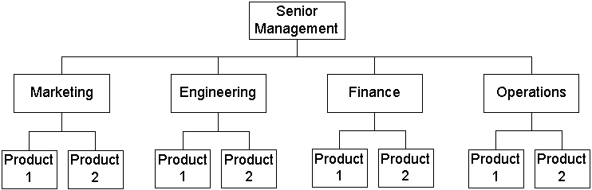
Project Human Resource Management
1.4 Knowledge & Attributes of a Project Manager
Organization structures for managing projects
(i) Functional Organizational Structure
(using an existing organization structure to manage Project)
(using an existing organization structure to manage Project)
Staff
1
Staff
2
Staff
1
Staff
2
Staff
1
Staff
2
Staff
1
Staff
2
E.g. Transfer equipment to new office
This project is managed by the Operations manager and assisted by ONE personnel from every other departments

Slide 83
Project Human Resource Management
1.4 Knowledge & Attributes of a Project Manager
Organization structures for managing projects
(i) Functional Organizational Structure
Staff
1
Staff
2
Staff
1
Staff
2
Staff
1
Staff
2
Staff
1
Staff
2
Pros
Cost savings
Cons
Project leaders have little power
Conflicts of priorities
(Transfer equipment to new office is not the staffs regular jobs)

Slide 84
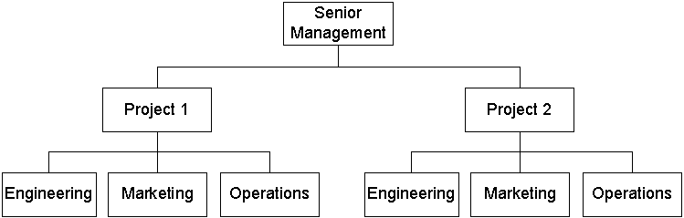
Project Human Resource Management
1.4 Knowledge & Attributes of a Project Manager
Organization structures for managing projects
(ii) Project Organizational Structure
Project managers report to the CEO / Sr Mgmt
E.g. of businesses where work is organized around projects:
Software development companies
Construction companies
Event mgmt. companies
Can you give 1 e.g? _______

Slide 85
Project Human Resource Management
1.4 Knowledge & Attributes of a Project Manager
Organization structures for managing projects
(ii) Project Organizational Structure
Advantages
Unity of command
Highly responsive to project’s objectives/ customer needs
Disadvantages
Duplication of facilities
Cost inefficiency of resources
(each team member report to and receive order form only one manager)

Slide 86
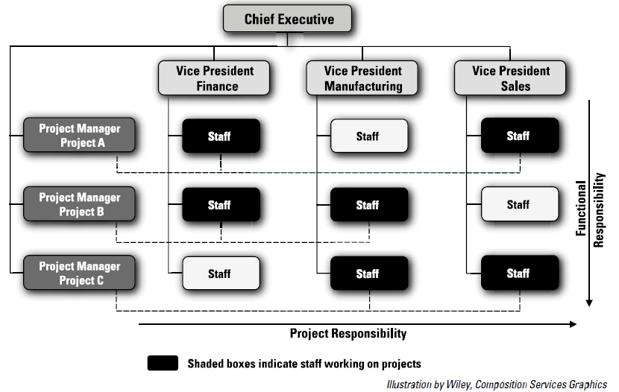
Project Human Resource Management
1.4 Knowledge & Attributes of a Project Manager
Organization structures for managing projects
(iii) Matrix Organizational Structure
Combination of functional and project structures.
Project managers often have staffs from various functional areas working on their projects. (E.g Project C ______ )
Adv: efficient use of resources
Disadv: one staff report to 2 managers/bosses

Slide 87
Project Human Resource Management
1.4 Knowledge & Attributes of a Project Manager
1. Plan HR Management
2. Acquire Project Team
3. Develop Project Team
4. Manage Project Team
Quick Review …
3 Organization structures for the project:
The Functional Structure
The Project Structure
Matrix Structure

Slide 88
Project Human Resource Management
1.4 Knowledge & Attributes of a Project Manager
1. Plan HR Management
2. Acquire Project Team
3. Develop Project Team
4. Manage Project Team
2. Acquire Project Team
Get the personnel needed and assigned them to work on the project
Tool (e.g. Microsoft Project) and techniques:
Resource assignment
Resource loading
Resource leveling
Outputs: project staff assignments, resource calendars.
(to specify who perform what task)
(analyse of the total amt of work assigned to a resource over a time period)

Slide 89
Tool & techniques for project team acquisition
Resource assignment
Resource loading
Resource leveling
To assign particular personnel to their projects or to acquire additional human resources needed to staff the project.
PM with strong influencing & negotiating skills are often good at getting internal people to work on their projects.
Main outputs: project staff assignments, resource availability information, updates to the staffing management plan, project team directory.
Amount of individual resources an existing schedule requires during specific time periods.
Help PM and individuals to develop schedules.
Overallocation: more resources than are available are assigned to perform work at a given time. E.g. individual have to work 24 hours a day to meet the allocated schedule.
A technique for resolving resource conflicts (overallocation & underallocation).
Purpose: to create a smoother distribution of resource usage.
PM examine the PERT chart for areas of slack or float, and to identify resource conflicts.
E.g. remove overallocations by delaying noncritical tasks, which does not result in an overall schedule delay.
Therefore, resource leveling aims to minimize period-by-period variations in resource loading by shifting tasks within their slack allowances.

Slide 90
Project Human Resource Management
1.4 Knowledge & Attributes of a Project Manager
1. Plan HR Management
2. Acquire Project Team
3. Develop Project Team
4. Manage Project Team
3. Develop Project Team
Purpose: to ensure that people can work together more effectively to improve project performance.
Main outputs: team performance assessments, enterprise environmental factors updates.
The Tuckman 5 stages of team development:
Forming (first stage)
Storming
Norming
Performing
Adjourning (last stage)
Describes what a team will goes through from start to end.

Slide 91
The Tuckman’s 5 stages of Team Development
1.4.1 e. Project HR Management
(what a team will goes through from start to end.)
Forming
Project team is form and members are introduced to each other
(e.g. a team consisting of developers, testers and a UI designer is formed for a new mobile app project)
This stage is necessary but little work is achieved
Storming
Conflict emerges as team members have differing opinions, challenge ideas, and compete for influence.
This is a turbulent stage where disagreements occur
(e.g. Developers start writing code, but disagreements arise over coding standards (indentation, naming conventions, percentage of comment lines, etc.)
Norming
This stage is achieved when conflicts are resolved
(established acceptable rules and standards)
Team members begins to collaborate effectively
Performing
Project team is united. Problems are brought up, discussed and then solved
Level of work performance is high; Productivity at its optimum
Adjourning
The team is dissolved after all works have been successfully completed and reaches its goals.

Slide 92
Project Human Resource Management
1.4 Knowledge & Attributes of a Project Manager
1. Plan HR Management
2. Acquire Project Team
3. Develop Project Team
4. Manage Project Team
4. Manage Project Team:
Track team member performance,
Motivate team members,
Provide timely feedback,
Resolve issues and conflicts
etc
PM must ensure that people can work together as a team to achieve project goals

Slide 93
Knowledge of a PM
1.4 Knowledge & Attributes of a Project Manager
10 Knowledge Areas
Scope
Stakeholders
Time
Integration
Procurement
Cost
Risk
Quality
(ch3)
Communication
Human Resource

Slide 94


Project Stakeholder Management
1.4 Knowledge & Attributes of a Project Manager
Purpose: to identify the people, groups or organizations that could impact or be impacted by the project,
to analyze stakeholder expectations and their impact on the project
to develop appropriate management strategies to effectively engage stakeholders in project decisions and execution.
4 processes:
Identify Stakeholders
Plan Stakeholder Engagement
Manage Stakeholder Engagement
Monitor Stakeholder Engagement

Slide 95
Project Stakeholder Management
1.4 Knowledge & Attributes of a Project Manager
1. Identify Stakeholders
2. Plan Stakeholder Engagement
3. Manage Stakeholder Engagement
4. Monitor Stakeholder Engagement
1. Identify Stakeholders
Identify the people, groups, or organizations that could impact or be impacted by a decision, activity, or outcome of the project; and analyze and document relevant information regarding their interests, involvement, interdependencies, influence, and potential impact on project success.
Output: stakeholder register.

Slide 96
Project Stakeholder Management
1.4 Knowledge & Attributes of a Project Manager
Stakeholder register (e.g. 1)
(Project = To develop a Web-based Attendance System (WAS) for AAA University)
No | Indiv/GROUP | JOB POSITION | ROLE | Expectation
1 | Top management | President, Vice presidents | Project sponsor
2 | Academics | Professors, lecturers, tutors. | Users (generate attendance code for students)
3 | Students | Course-rep, class-rep, ordinary students | Users (taking own class attendance)
4 | JACK | Project manager | Manage the WAS development project
5 | Team members | Developers, testers | Develop & test WAS
6 | …
7 | ...

Slide 97
The people, groups or organizations that could impact or be impacted by a decision, activity or outcome of the project
Project Stakeholder Management
If you are assigned to manage a project, you need to know who are the stakeholders
1.4 Knowledge & Attributes of a Project Manager
Stakeholder register (e.g. 2)
(Project = To develop a Web-based Attendance System (WAS) for AAA University)
No | Indiv/GROUP | JOB POSITION | ROLE | Expectation
1 | Top management | President, Vice presidents, Deans | Project sponsor
2 | Academics | Professors, lecturers, tutors. | Users (generate attendance code for students, … )
3 | Students | Course-rep, class-rep, ordinary students | Users (taking own class attendance, …)
4 | JACK | Project manager | Manage the WAS development project
5 | JIM | UI & DB Designer | Design sys UI & Database
6 | JOHN | Developer | Develop & test the WAS
7 | ...
Work with stakeholders to meet their needs/expectations

Slide 98
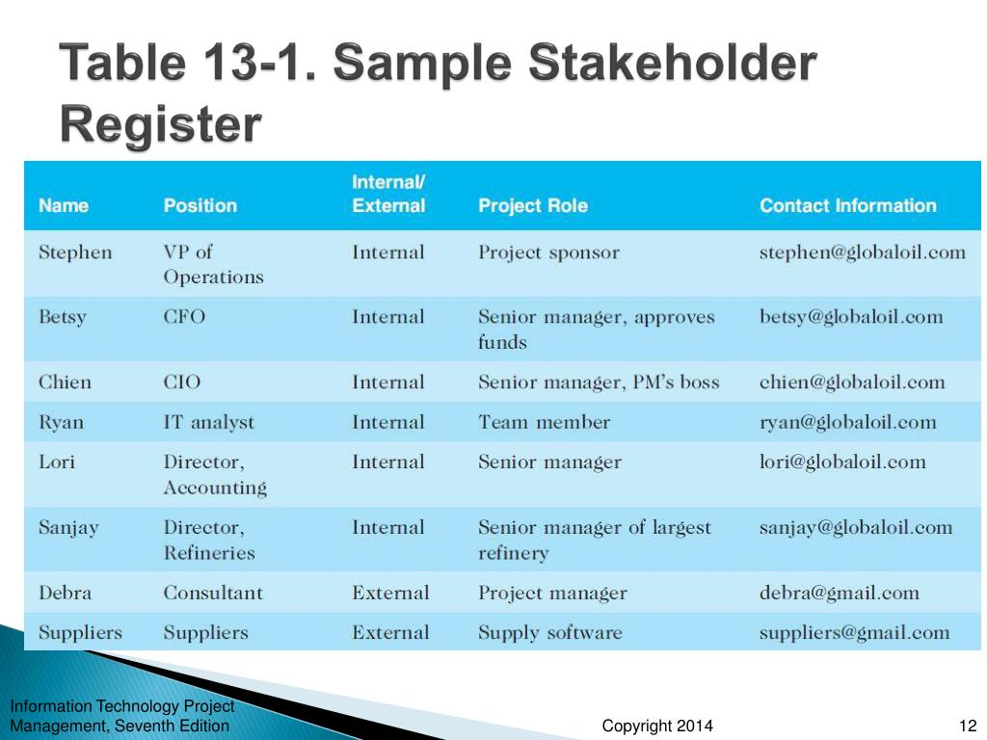
Project Stakeholder Management
1.4 Knowledge & Attributes of a Project Manager
1. Identify Stakeholders
Identify the people, groups, or organizations that could impact or be impacted by a decision, activity, or outcome of the project; and analyze and document relevant information regarding their interests, involvement, interdependencies, influence, and potential impact on project success.
Output: Stakeholder register (e.g. 3)
PS: A high-ranking manager who champions and supports a project
(Larson, 2021)
(Schwalbe, 2019)

Slide 99
Project Stakeholder Management
1.4 Knowledge & Attributes of a Project Manager
1. Identify Stakeholders
2. Plan Stakeholder Engagement
3. Manage Stakeholder Engagement
4. Monitor Stakeholder Engagement
2. Plan Stakeholder Management
Develop appropriate management strategies to effectively engage stakeholders throughout the project life cycle, based on the analysis of their needs, interests, and potential impact on project success.
Output: stakeholder management plan.

Slide 100
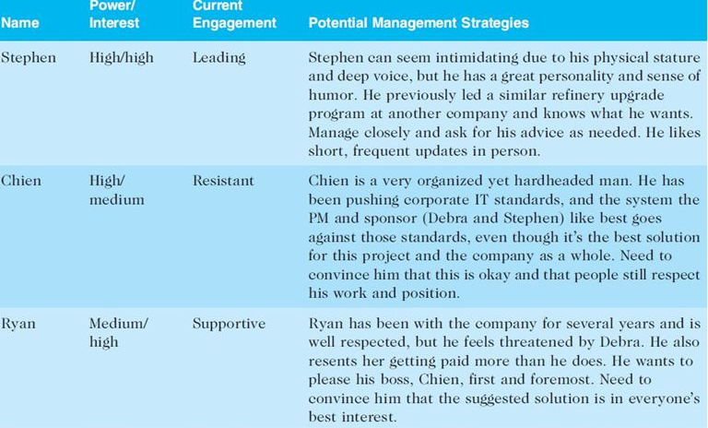
Project Stakeholder Management
“Leading” status means Stephen is an influential person, who is also actively involved in the project
1.4 Knowledge & Attributes of a Project Manager
2. Plan Stakeholder Management
Develop appropriate management strategies to effectively engage stakeholders throughout the project life cycle, based on the analysis of their needs, interests, and potential impact on project success. Output: stakeholder management plan (e.g.)
Knows what he wants
and what he likes

Slide 101
Project Stakeholder Management
1.4 Knowledge & Attributes of a Project Manager
1. Identify Stakeholders
2. Plan Stakeholder Engagement
3. Manage Stakeholder Engagement
4. Monitor Stakeholder Engagement
3. Manage Stakeholder Engagement/ relation
Communicate and work with stakeholders to meet their needs/expectations, address issues as they occur, and foster appropriate stakeholder engagement in project activities throughout the project life cycle.
Output: issue log, change requests.

Slide 102
Project Stakeholder Management
1.4 Knowledge & Attributes of a Project Manager
1. Identify Stakeholders
2. Plan Stakeholder Engagement
3. Manage Stakeholder Engagement
4. Monitor Stakeholder Engagement
4. Monitor Stakeholder Engagement
Monitor stakeholder relationships and adjust plans and strategies to engage stakeholders as needed.
Main output: work performance information & change request

Slide 103
Knowledge of a PM
L3: Quick Review of PrevL
1.4 Knowledge & Attributes of a Project Manager
10 Knowledge Areas
Scope
Stakeholders
Time
Integration
Procurement
Cost
Risk
Quality
(ch3)
Communication
Human Resource

Slide 104

Project Communication Management
1.4 Knowledge & Attributes of a Project Manager
Purpose: To collect, disseminate and store of project information in a timely manner
3 processes:
Plan Communications Management
Manage Communications
Control communications

Slide 105
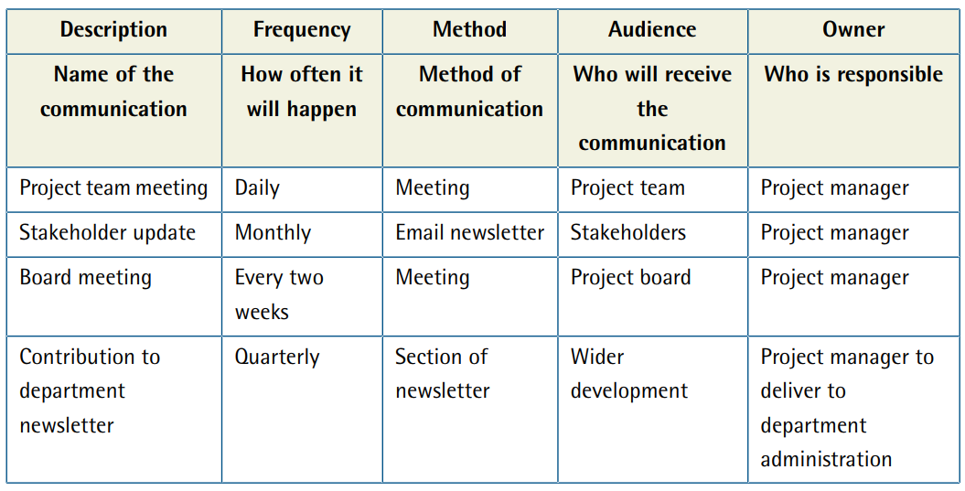
Project Communication Management
1.4 Knowledge & Attributes of a Project Manager
1. Plan Communication Management
Develop an appropriate approach and plan for project communications based on stakeholder’s information needs and requirements, and available organizational assets.
Key benefit: identifies and documents the approach to communicate most effectively and efficiently with stakeholders.
1. Plan Communications Management
2. Manage Communications
3. Control communications
How to develop a Project Communication Plan?
PTM is to collect & disseminate project information
email newsletter to keep stakeholders informed of project progress

Slide 106
Project Communication Management
1.4 Knowledge & Attributes of a Project Manager
2. Manage Communications
Create, collect, disseminate, store, retrieve, and ultimately dispose project information according to the communication management plan.
Key benefit: enables an efficient and effective communications flow between project stakeholders.
1. Plan Communications Management
2. Manage Communications
3. Control communications
Project team (Developers, QA team )
SW Dev. Co. side (e.g CEO, PM)
Client side (e.g CEO, Dept mgrs, etc)
Means other relevant parties

Slide 107
Project Communication Management
3. Control Communications
Monitor and control communications throughout the entire project life cycle to ensure the information needs of project stakeholders are met.
(note: if some project stakeholders are no longer relevant to the project then these people should be removed from the audience list)
Key benefit: ensures an optimal information flow among all communication participants, at any moment in time.
1.4 Knowledge & Attributes of a Project Manager
1. Plan Communications Management
2. Manage Communications
3. Control communications
The purpose of COMM MGMT. is to collect, disseminate and store of project information in a timely manner
so that stakeholders don't have to guess the STATUS of a project.

Slide 108

Project Risk Management
1.4 Knowledge & Attributes of a Project Manager
6 major processes:
Plan Risk Management
Identify Risk
Perform Qualitative Risk Analysis
Perform Quantitative Risk Analysis
Plan Risk Response
Control Risk
S / Ch 5

Slide 109
Project Risk Management
1.4 Knowledge & Attributes of a Project Manager
1. Plan Risk Management
2. Identify Risk
3. Perform Qualitative Risk Analysis
4. Perform Quantitative Risk Analysis
5. Plan Risk Response
6. Control Risk
1. Plan Risk Management
Decide how to approach and plan the risk management activities for the project.
By reviewing the project scope statement; cost, schedule, and communications management plans; enterprise environmental factors; and organizational process assets
Main output: risk management plan
S / Ch 5

Slide 110
Project Risk Management
1.4 Knowledge & Attributes of a Project Manager
1. Plan Risk Management
2. Identify Risk
3. Perform Qualitative Risk Analysis
4. Perform Quantitative Risk Analysis
5. Plan Risk Response
6. Control Risk
2. Identify Risk
Determine which risks are likely to affect a project and documenting the characteristics of each
Main output: the start of a risk register
S / Ch 5

Slide 111
Project Risk Management
1.4 Knowledge & Attributes of a Project Manager
1. Plan Risk Management
2. Identify Risk
3. Perform Qualitative Risk Analysis
4. Perform Quantitative Risk Analysis
5. Plan Risk Response
6. Control Risk
3. Perform Qualitative Risk Analysis
Prioritize risks based on their probability and impact of occurrence.
After identifying risks, various tools and techniques can be used by project teams to rank risks and update information in the risk register
Main output: risk register updates.
S / Ch 5

Slide 112
Project Risk Management
1.4 Knowledge & Attributes of a Project Manager
1. Plan Risk Management
2. Identify Risk
3. Perform Qualitative Risk Analysis
4. Perform Quantitative Risk Analysis
5. Plan Risk Response
6. Control Risk
4. Perform Quantitative Risk Analysis
Numerically estimate the effects of risks on project objectives.
Main output: risk register updates.
S / Ch 5

Slide 113
Project Risk Management
1.4 Knowledge & Attributes of a Project Manager
1. Plan Risk Management
2. Identify Risk
3. Perform Qualitative Risk Analysis
4. Perform Quantitative Risk Analysis
5. Plan Risk Response
6. Control Risk
5. Plan Risk Responses
Take steps to enhance opportunities and reduce threats to meeting project objectives.
Using outputs from the preceding risk management processes, project teams can develop risk response strategies that often result in updates to the risk register, project management plan, and other project documents as well as risk-related contract decisions
S / Ch 5

Slide 114
Project Risk Management
1.4 Knowledge & Attributes of a Project Manager
1. Plan Risk Management
2. Identify Risk
3. Perform Qualitative Risk Analysis
4. Perform Quantitative Risk Analysis
5. Plan Risk Response
6. Control Risk
6. Control Risk
Monitor identified and residual risks, identify new risks, carry out risk response plans, and evaluate the effectiveness of risk strategies throughout the life of the project.
Main outputs: change requests and updates to the risk register.
S / Ch 5

Slide 115
1.4 Knowledge & Attributes of a Project Manager
10 Knowledge Areas
Scope
√
Stakeholders
Time
√
√
Integration
Procurement
Cost
√
Risk
Quality
(CHAP5)
(CHAP3)
Communication
Human Resource
√
√

Slide 116
Project Procurement Management
1.4 Knowledge & Attributes of a Project Manager
Includes the processes required to acquire goods and services for a project from an outside source (supplier/vendor/contractor/seller).
Organizations can be either the buyer or seller of products or services under a contract.
3 main processes in Procurement Management:
Plan Procurement Management
Conduct Procurement
Control Procurement
Examples of Goods to acquire
Hardware:
servers, computers, laptops, tablets, mobile devices, printers, scanners, etc.
Software:
operating systems, development tools, project management software, database management systems, MS Office, etc
Examples of services to acquire
Software testing:
usability testing, etc
Training:
provide training for end-users

Slide 117

Project Procurement Management
1.4 Knowledge & Attributes of a Project Manager
Procurement Management Processes
1. Plan Procurement Management
2. Conduct Procurement
3. Control Procurement
4. Close Procurement
1. Plan Procurement Management involve:
Decide what & when to ACQUIRE, determine the type of contract, and describe the work for the contractors/ suppliers.
Outputs: procurement management plan, statements of work, make-or-buy decisions, procurement documents, source selection criteria, and change requests.

Slide 118
Project Procurement Management
1.4 Knowledge & Attributes of a Project Manager
1. Plan Procurement Management
2. Conduct Procurement
3. Control Procurement
4. Close Procurement
2. Conduct Procurement
Invite contractors/suppliers to submit proposal
Obtain contractors/suppliers responses,
Select contractors/suppliers,
Award contracts.
Main output: Selected seller(s), agreement, change request

Slide 119
Project Procurement Management
1.4 Knowledge & Attributes of a Project Manager
1. Plan Procurement Management
2. Conduct Procurement
3. Control Procurement
4. Close Procurement
3. Control Procurement
Manage relationships with sellers,
monitor contract performance,
make changes if needed,
close the contracts
Main outputs: Work performance info, change request, procurement documentation updates & closed procurement.

Slide 120
Knowledge of a PM
1.4 Knowledge & Attributes of a Project Manager
10 Knowledge Areas
Scope
Stakeholders
Time
Integration
Procurement
Cost
Risk
Quality
Communication
Human Resource

Slide 121

Attributes of a PM
1.4 Knowledge & Attributes of a Project Manager
What are skills needed to be a PM?
Personal characteristics
Task oriented vs People oriented
Charismatic
Behavioral skills
Interpersonal skill
Communication skills
-- aka people skills: tactics a person uses when interacting with others
-- PM need to interact with project team members & stakeholders (see “communication plan”)
-- comm skills including listening skills & ability to decode non-verbal cues
General business skills
MBA vs MSc?
Technical skills
IT/IS knowledge
Estimate project costs
Analyse Costs & Benefits
Calculate NP, PB, ROI, NPV

Slide 122
Attributes of a PM
1.4 Knowledge & Attributes of a Project Manager
Behavioral skills
Interpersonal skill
Communication skills
Personal characteristics
Task oriented vs People oriented
Charismatic
Aspect | Task-Oriented
Focus | Tasks & Deadlines
Communication Style | Directive (e.g. Follow these steps to complete the task)
People-Oriented
Team & Relationships
Collaborative (e.g. what ideas do you all have to do this task?"
General business skills
MBA vs MSc?
Technical skills
IT/IS knowledge
A project manager should be task-oriented to keep the project on track and be people-oriented to keep the team engaged and motivated.

Slide 123
Leading vs Managing
1.4 Knowledge & Attributes of a Project Manager
The overriding function of management is to provide order and consistency to organizations, whereas the primary function of leadership is to produce change and movement.
Leadership can be defined as the process of moving a group(s) in some direction through mostly non-coercive means
Effective leadership is defined as leadership that produces movement in the long-term best interests of the group(s) (Kotter, 1988).
Thus, leadership is defined as the ability to influence people toward the attainment of goals

Slide 124


1.5 Project Management Failure
Project Objectives Vs Business Objectives
Causes of Project Failures
Critical Success Factor (CSF)

Slide 125


Introduction
1.5 Project Management Failure
Project Objectives
Is the targets that the project team is expected to achieve such as delivering:
the agreed functionality,
to the required level of quality,
on time and within budget
Business Objectives
For all the resources & efforts put in, Return generated > costs
3 Scenarios
A project meet the project objectives and meet the business objectives
A project meet the project objectives but fail to meet the business objectives
A project fail to meet the project objectives but successfully meet the business objectives
Notes:
The business case or similar document describes the necessary information from a business standpoint to determine whether or not the project is worth the required investment. It is commonly used for decision making by managers or executives above the project level. Typically, the business need and the cost-benefit analysis are contained in the business case to justify and establish boundaries for the project, and such analysis is usually completed by a business analyst using various stakeholder inputs. The sponsor should agree to the scope and limitations of the business case.

Slide 126
Introduction
1.5 Project Management Failure
Project Objectives
Is the targets that the project team is expected to achieve such as delivering:
the agreed functionality,
to the required level of quality,
on time and within budget
Business Objectives
For all the resources & efforts put in, Return generated > costs
3 Scenarios
A project meet the project objectives and meet the business objectives
A project meet the project objectives but fail to meet the business objectives
A project fail to meet the project objectives but successfully meet the business objectives
E.g. a computer game is delivered on time and within budget but then not selling well.
E.g. a computer game is completed few months late and over budget but somehow benefits gained > the costs
Conclusion: Which projects you will considered as successful?
Notes:
The business case or similar document describes the necessary information from a business standpoint to determine whether or not the project is worth the required investment. It is commonly used for decision making by managers or executives above the project level. Typically, the business need and the cost-benefit analysis are contained in the business case to justify and establish boundaries for the project, and such analysis is usually completed by a business analyst using various stakeholder inputs. The sponsor should agree to the scope and limitations of the business case.

Slide 127
Project Failure vs Business Failure
1.5 Project Management Failure
A project is considered fail when:
It does not satisfy the stakeholders requirements
It does not meet the project objectives – time, budget, quality
A project can be successfully delivered but then be a business failure
On the other hand, a project could be late and over budget (fail to meet project objectives) but it generates benefits that outweigh the costs (successfully meet the business objectives).
A computer game is delivered on time and within budget but then not selling well is a kind of biz risk.
How to reduce business risks?
Carry out market surveys before ____
Carry out competitor analysis
Develop prototype and let potential users test drive the prototype
Notes:
The business case or similar document describes the necessary information from a business standpoint to determine whether or not the project is worth the required investment. It is commonly used for decision making by managers or executives above the project level. Typically, the business need and the cost-benefit analysis are contained in the business case to justify and establish boundaries for the project, and such analysis is usually completed by a business analyst using various stakeholder inputs. The sponsor should agree to the scope and limitations of the business case.

Slide 128

Project Failure vs Business Failure
1.5 Project Management Failure
Project Objectives
Time
Functionality (scope)
Internal Factors
Budget
Quality
Business Objectives
How to reduce business risks?
Benefits > costs
- Market Survey
- Competitor Analysis
- evaluation by potential users.
- etc.
External Factors
(E.g. a computer game is delivered on time and within budget but then not selling well)

Slide 129
Causes of Project Failure
1.5 Project Management Failure
Inadequacies or defects in project management will contribute to project failures.
Failures in project management may be categorized according to 3 levels:
Level 1 - Failures in the Project Management Context
Level 2 - Failures in the Project Management System
Level 3 - Failures in Planning and Control Processes

Slide 130
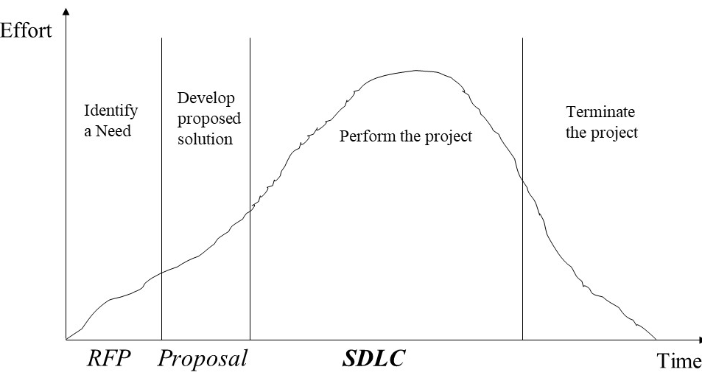
Level 1: Failures in the Project Management Context
1.5 Project Management Failure
Inappropriate “fit” of project organisation to project objectives, project tasks, top management, and environment at large. For example,
A game software needs project organizational structure which includes marketing personnel to promote it after accomplished. However, members of the team are assigned to the project without regards to proper skills and experience. Top management also does not yield adequate responsibility or authority to the project manager.
Not using appropriate project process model
E.g. Prototyping is used in a large and
complex system development which cannot
capture the user requirements effectively.
Lack of top management support
E.g. Lack of support from the financial department (difficult to get funding from the organization).
Lack of support from the sales and marketing department (no personnels to promote the new games software)

Slide 131
Level 2: Failures in the Project Management System
1.5 Project Management Failure
Traceable to project leadership, philosophy and practice
Include wrong project manager, neglect of systems approach in the project life cycle, and misuse of project management techniques
Examples:
the project manager is unable to control conflicts
Hardware, software, resources and facilities are viewed independently without relation to their overall project objectives – poor resource planning during the _____
Effort
Identify a Need
Develop proposed solution
Terminate the project
Perform the project
RFP
Proposal
SDLC
Time

Slide 132
Level 3: Failures in Planning & Control Processes
1.5 Project Management Failure
Include inadequate communication and planning, poor estimation, poor scheduling and lack of user involvement
Examples:
Information about scope, objectives, responsibility and acceptance criteria not documented early in the project
The behaviour of the project team discourages user involvement
(lack of user involvement will results in …
not meeting users needs)

Slide 133
Other factors that contribute to project failure
1.5 Project Management Failure
PM too optimistic
Poor team development
Under-allocation of resources
(situation where there are insufficient resources (people, equipment or budget) allocated to a project activity) – will impact on project schedule, quality, ___ .
to achieve its objectives within the specified timeframe and quality
Organization culture e.g. no team work, no sharing of information between employees
External factors e.g. government enforce new laws

Slide 134
1.6 Critical Success Factors (CSFs)
1.5 Project Management Failure
A key area where satisfactory performance is required for the organization to achieve its goals
A means of identifying the tasks and requirements needed for success
At the lowest level, CSFs become concrete requirements
A means to prioritize requirements
Make sure you have the support of top management.
Manage the project scope effectively.
Competent and experienced project teams
______
Etc

Slide 135

Summary
1.1 Introduction to Project Management
1.2 Project Life Cycle
1.3 Project Appraisal
1.4 Knowledge and Attributes of a Project Manager
1.5 Project Management Failure
Project Objectives Vs Business Objectives
Causes of project failures
1.6 Critical Success Factors (CSFs)
…
…
End of chapter 1

